Slide 1
Uncertain Knowledge and Reasoning-Quantifying Uncertainty

Slide 2
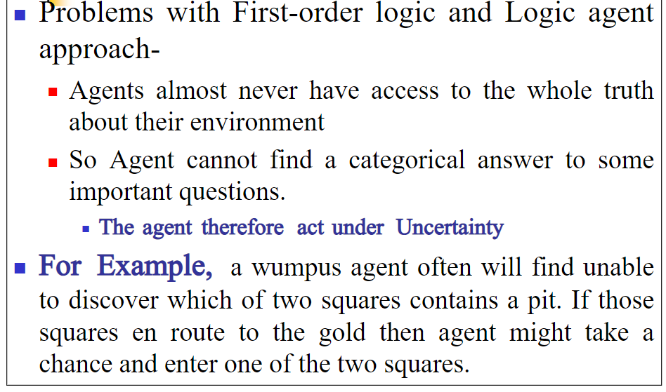

Slide 3
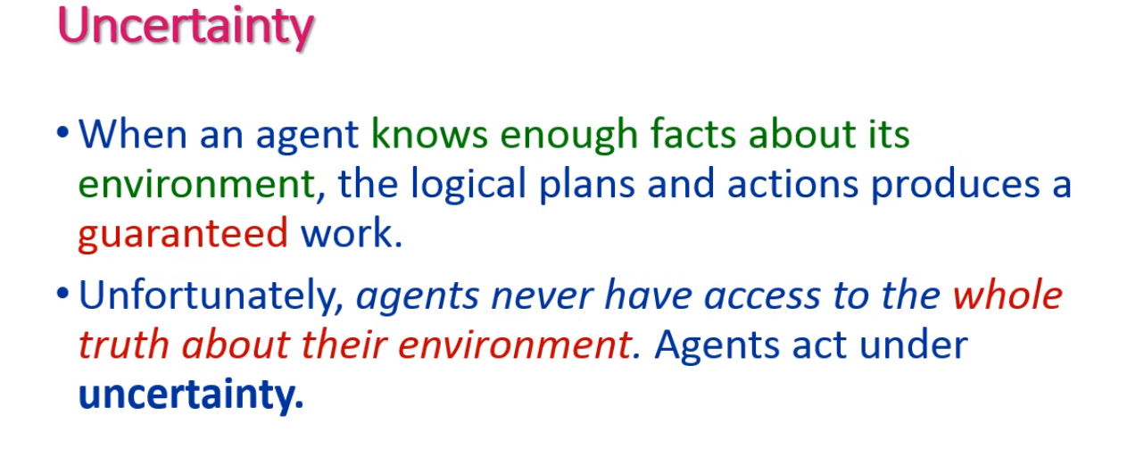


Slide 4
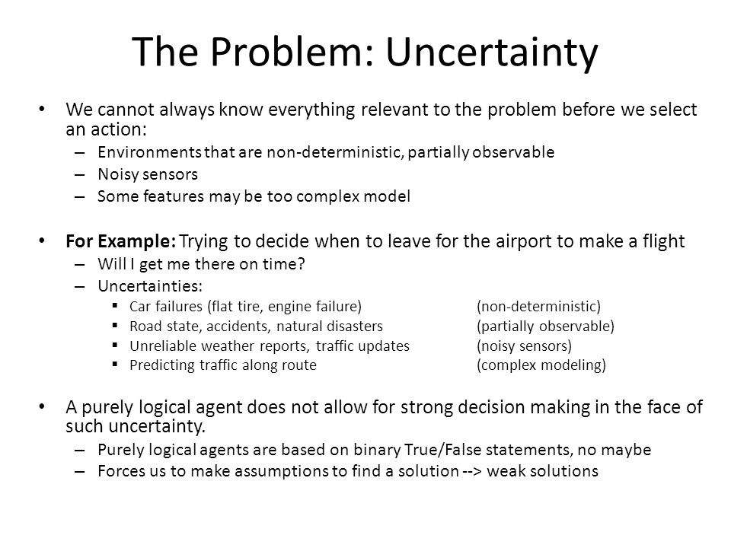

Slide 5
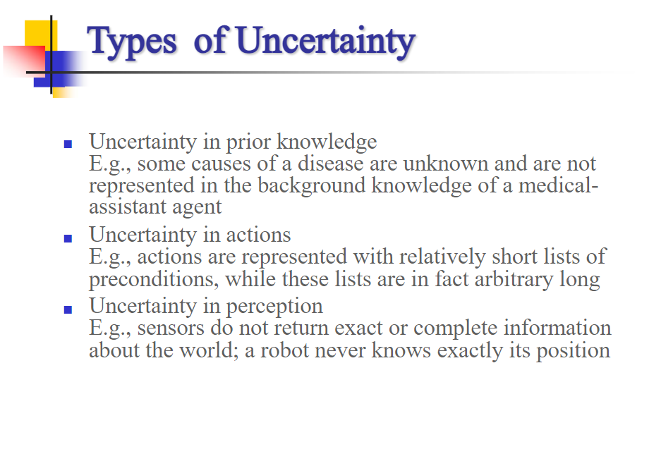
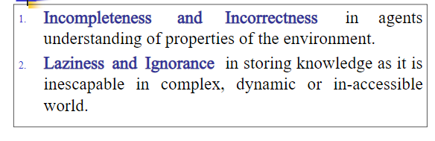

Slide 6
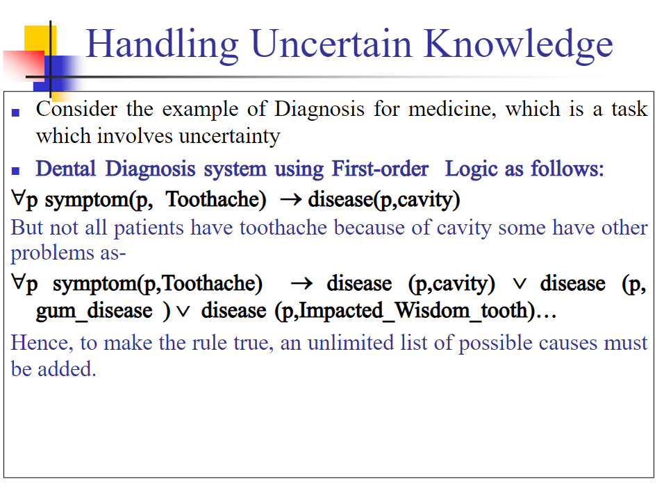

Slide 7
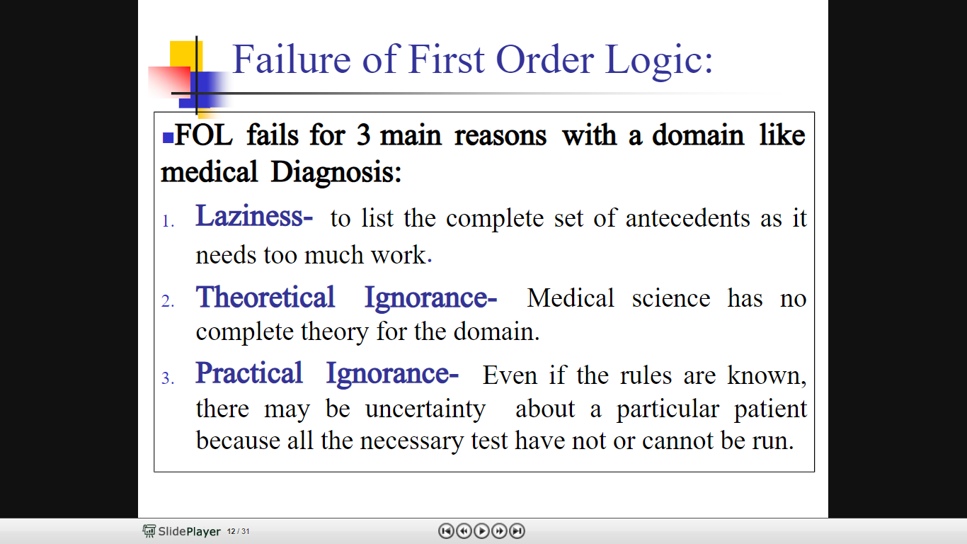

Slide 8
Probabilistic reasoning
Probabilistic reasoning is a way of knowledge representation where we apply the concept of probability to indicate the uncertainty in knowledge.
In probabilistic reasoning, we combine probability theory with logic to handle the uncertainty.
Need of probabilistic reasoning in AI:
When there are unpredictable outcomes.
When specifications or possibilities of predicates becomes too large to handle.
When an unknown error occurs during an experiment.

Slide 9
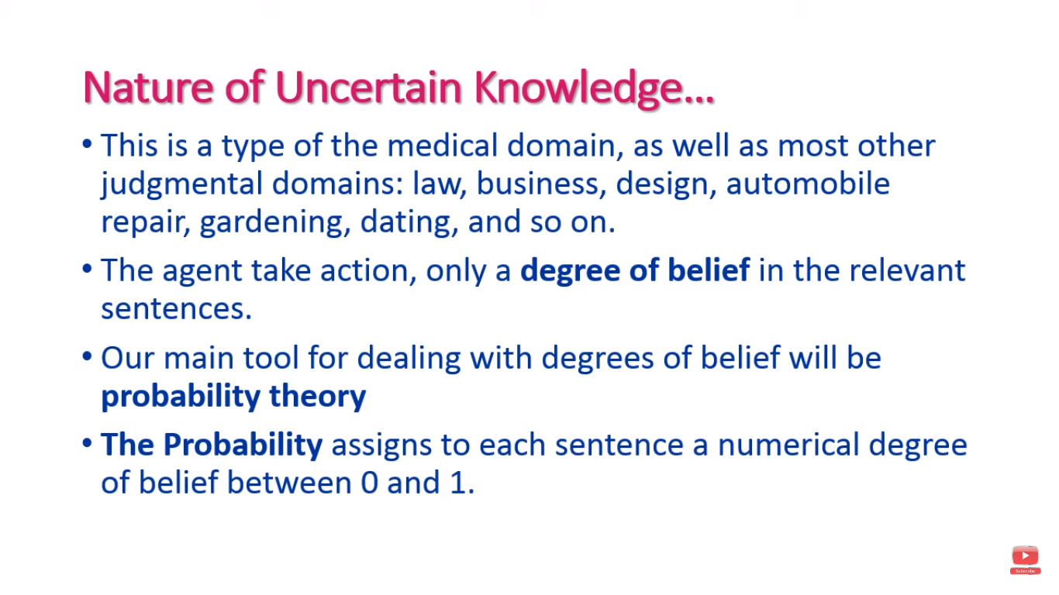

Slide 10
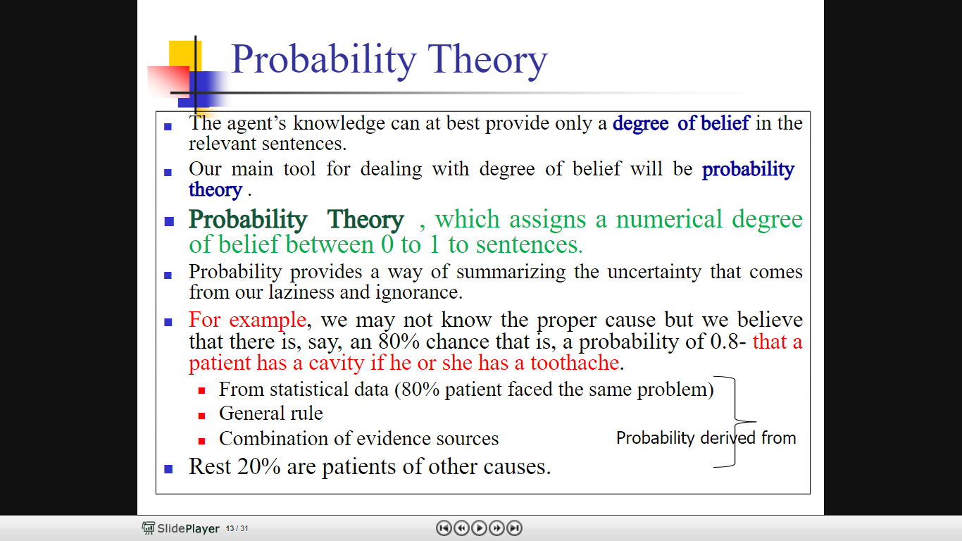

Slide 11
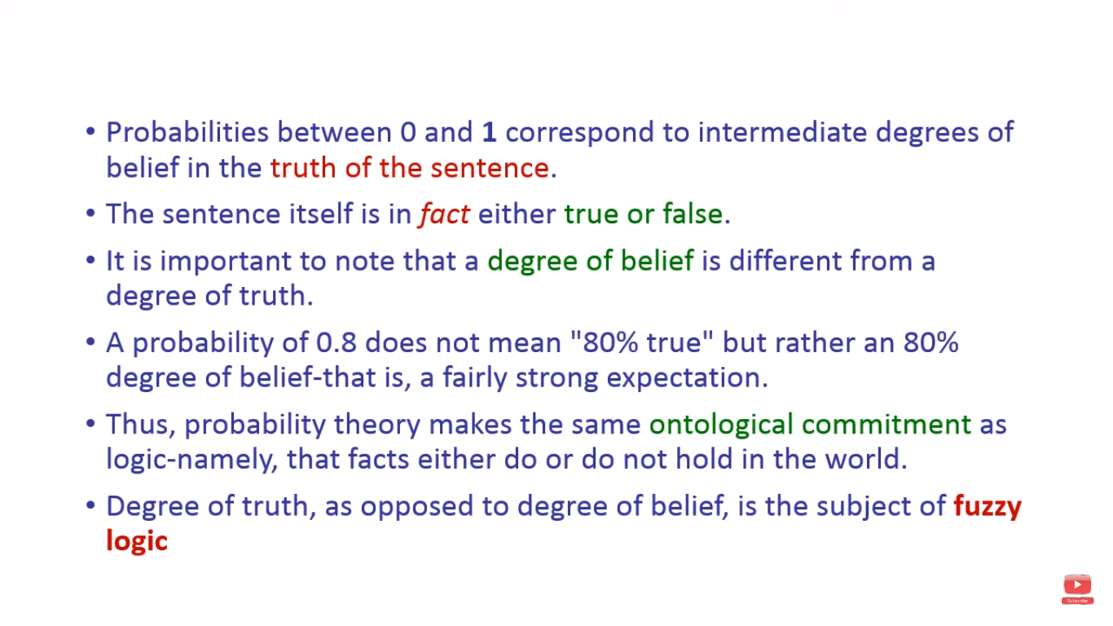

Slide 12
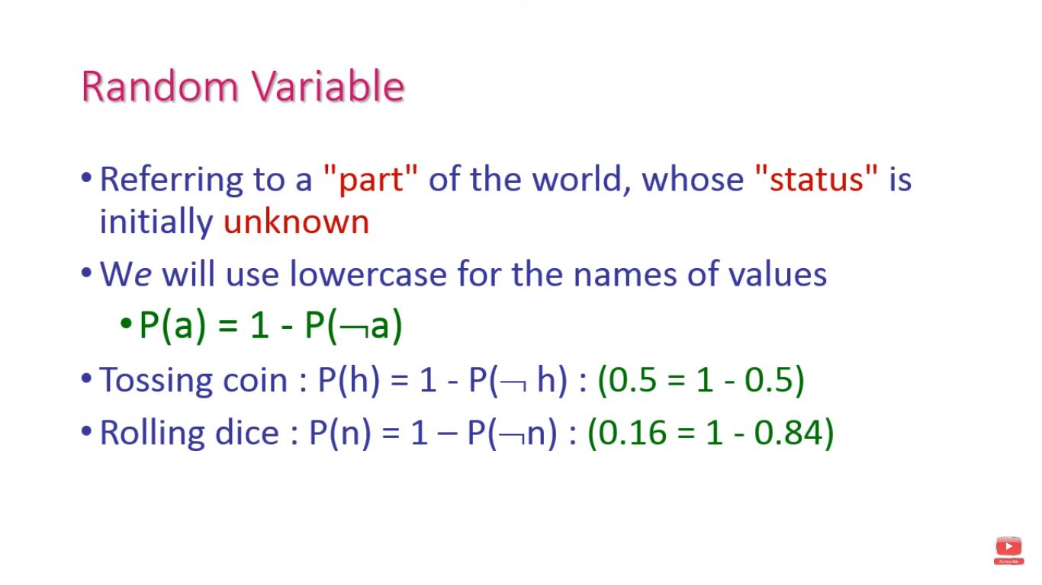
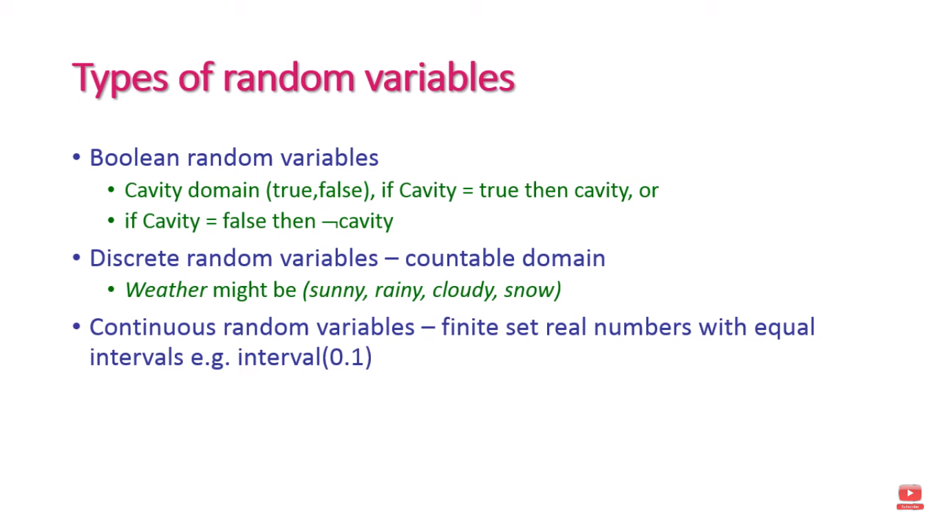

Slide 13
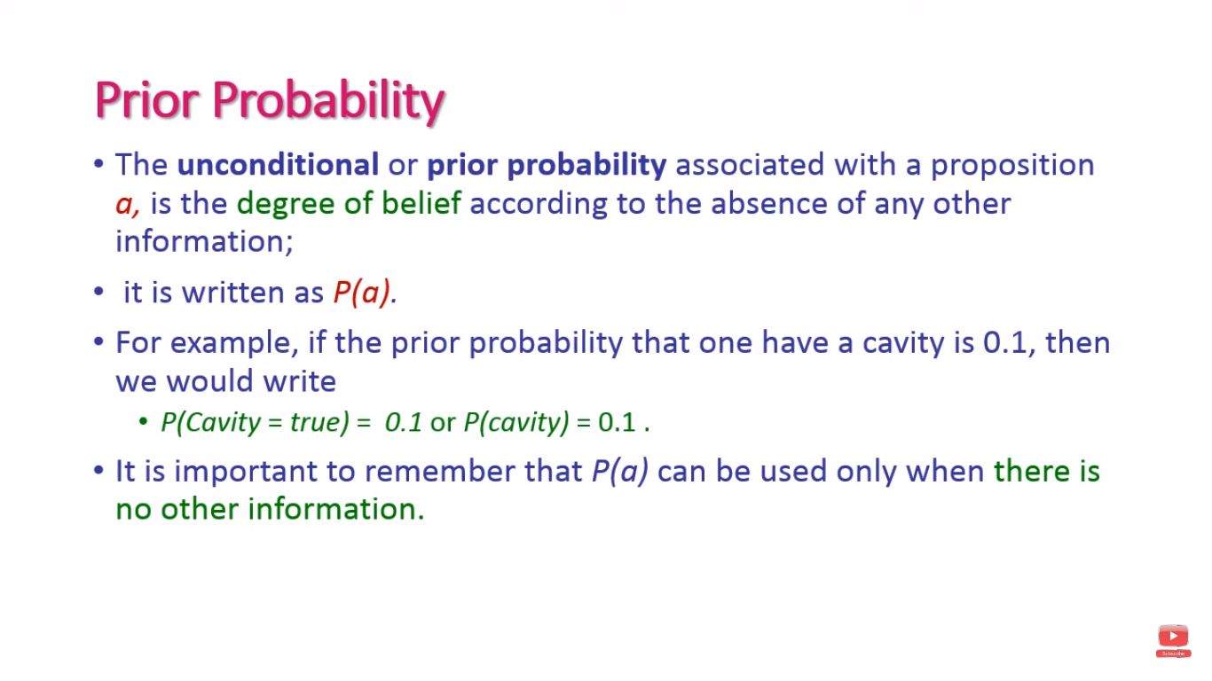

Slide 14
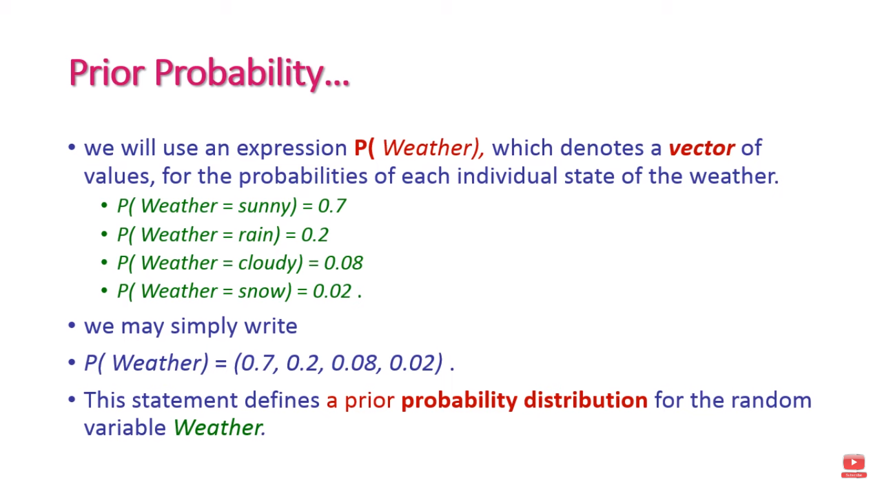

Slide 15
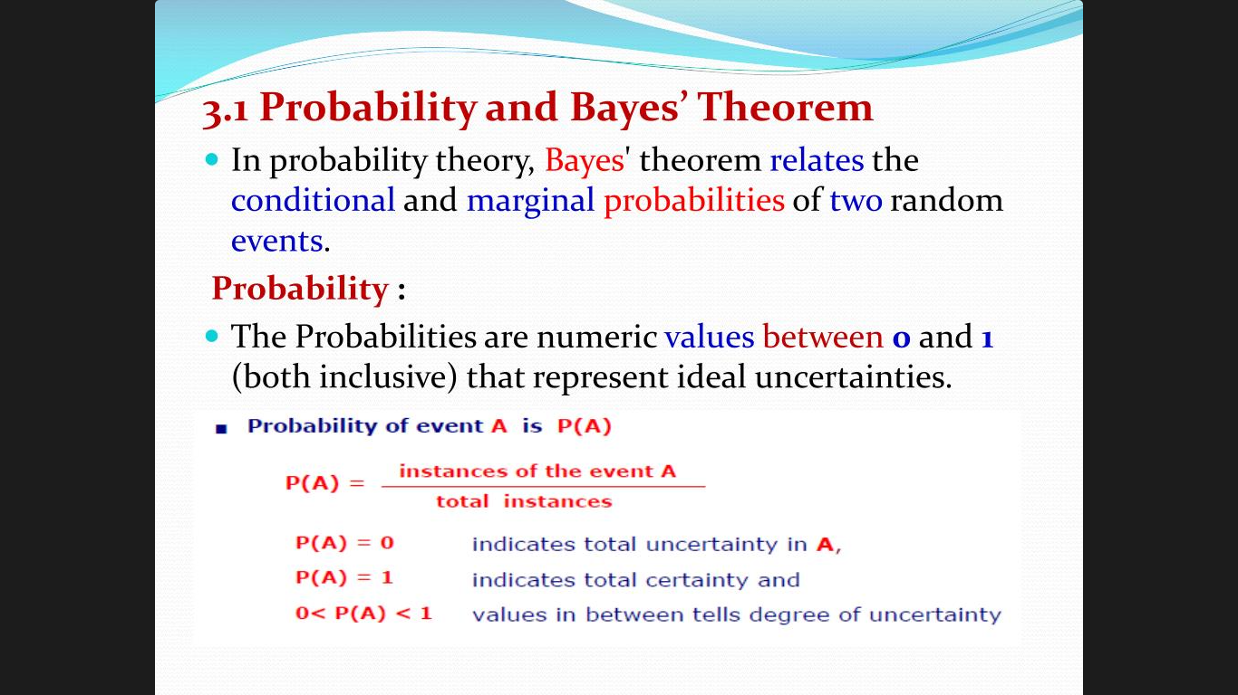

Slide 16
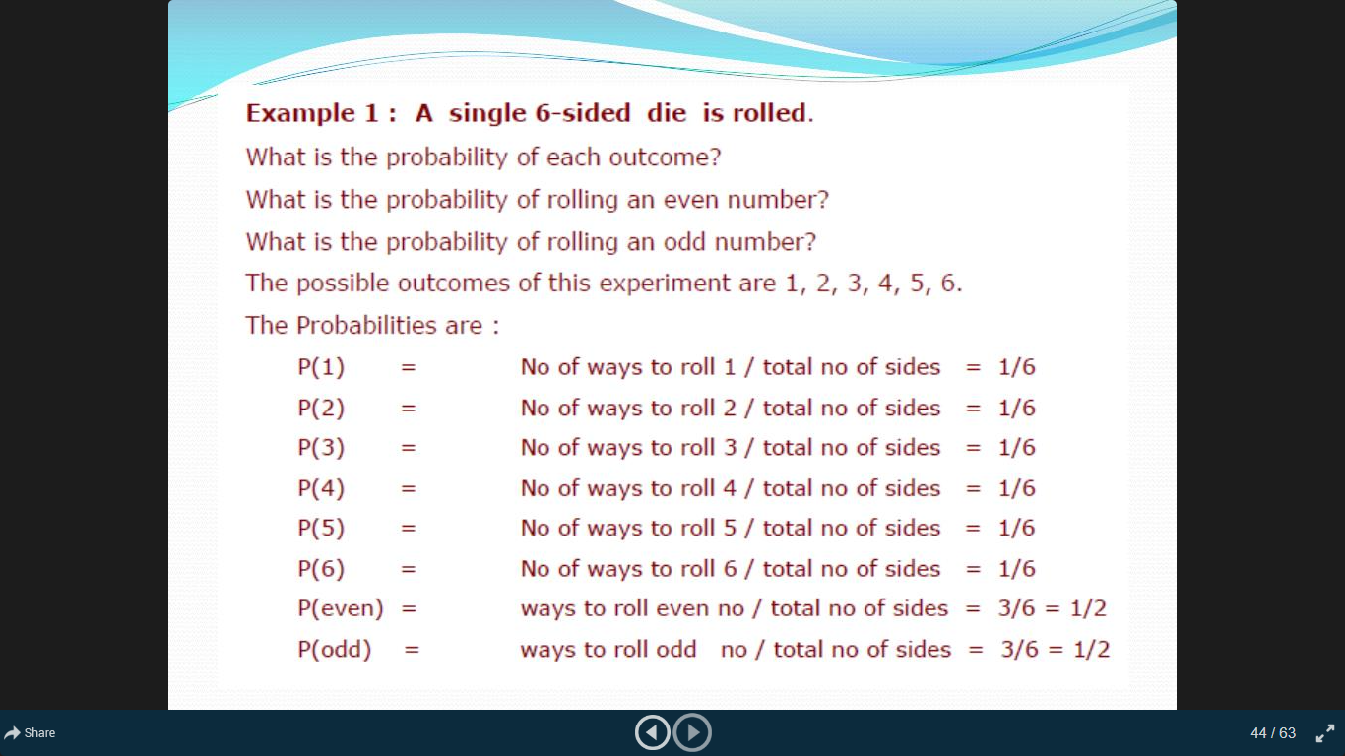

Slide 17
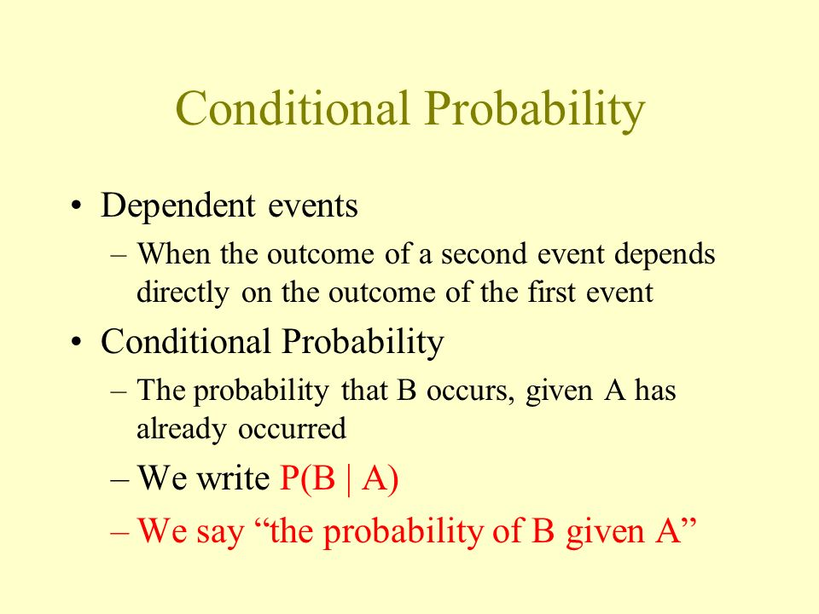

Slide 18
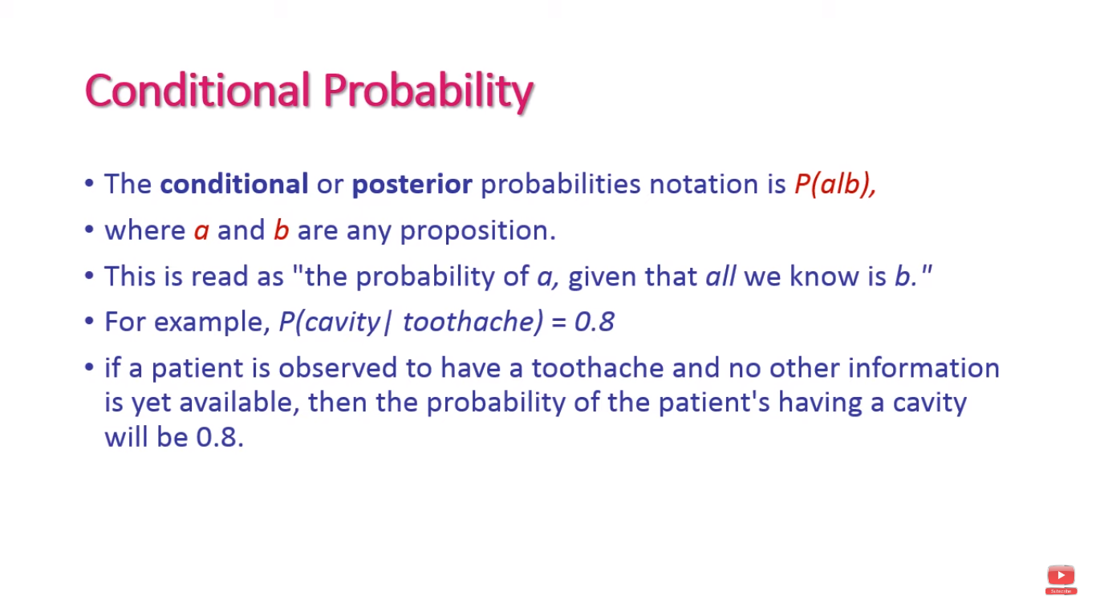

Slide 19
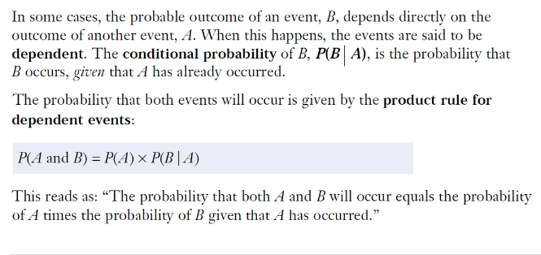
Conditional probability

Slide 20
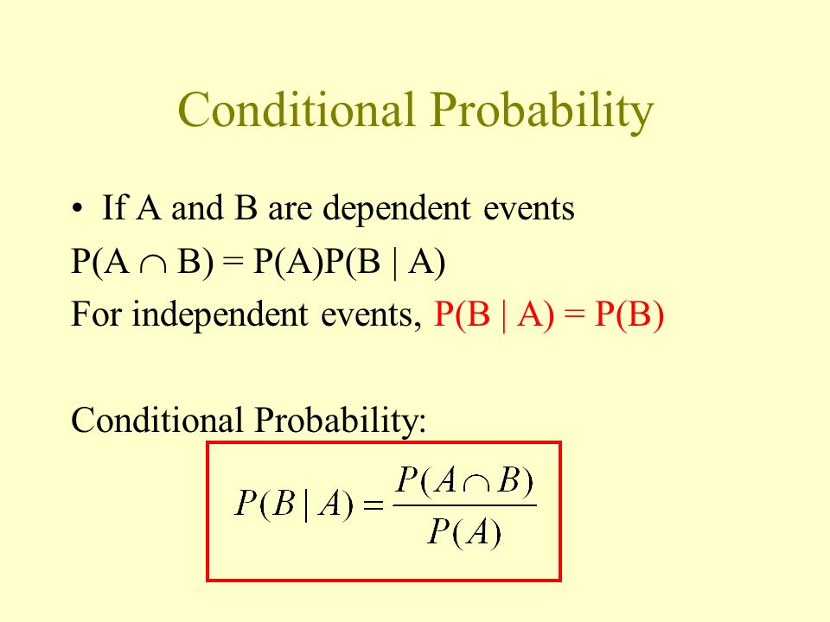

Slide 21
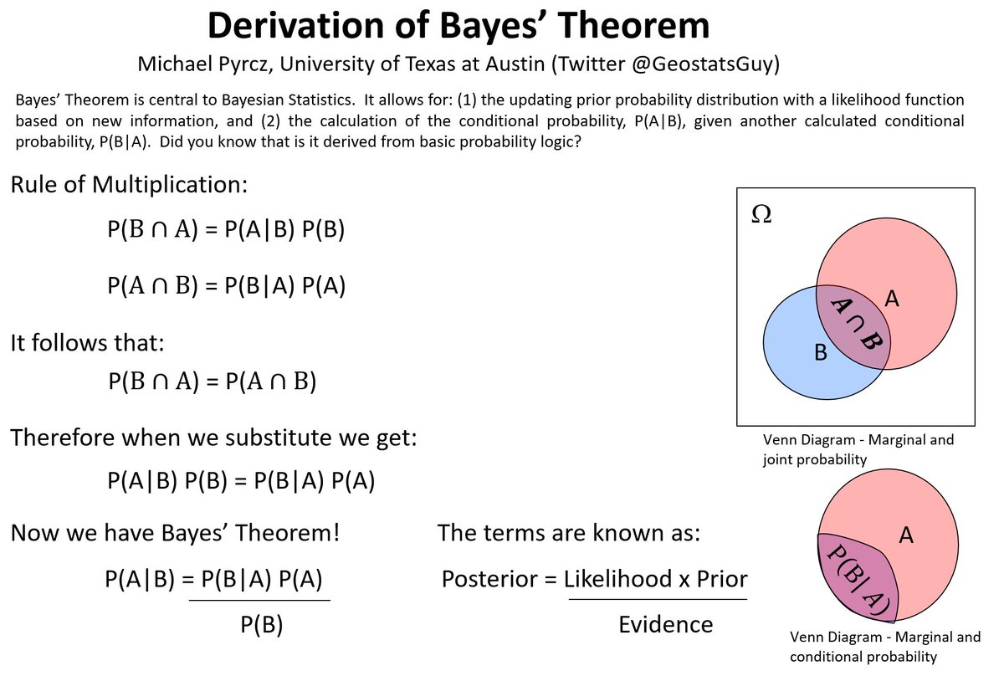

Slide 22
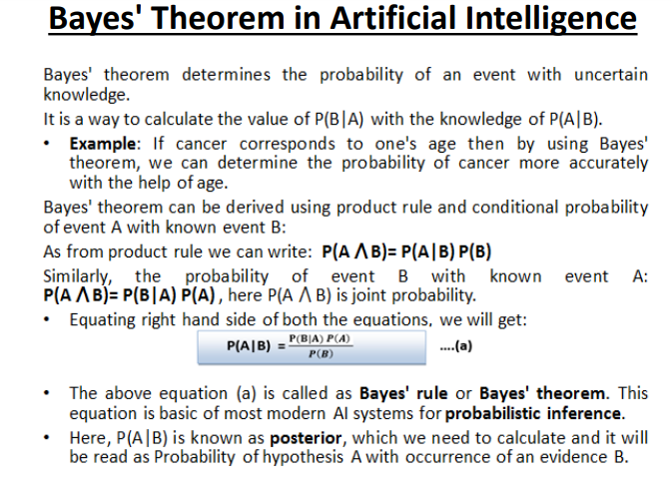

Slide 23
Naive-Bayes Classifier
An algorithm that implements classification, especially in a concrete implementation, is known as a classifier.
A Naïve-Bayes classifier is a simple probabilistic classifier based on applying Bayes' theorem with strong (naive) independent assumptions.
➢Named after Thomas Bayes ( 1702-1761), who proposed the Bayes Theorem.

Slide 24
Naïve Bayes
For a class, the previous generative model can be decomposed by n generative models of a single input.
Bayes classification
Difficulty: learning the joint probability
Naïve Bayes classification
Assumption that all input attributes are conditionally independent!
MAP classification rule: for
Product of individual probabilities

Slide 25
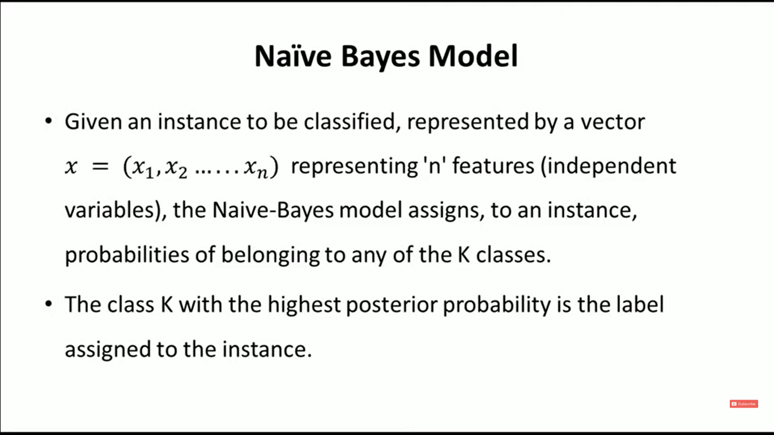

Slide 26
Explanation: Naïve-Bayes
Let,
X : Data sample whose class label is unknown.
H : Some hypothesis, such that X belongs to some class C.
P(H|X) : Probability that the hypothesis holds given the observed data sample X.
P(H|X) is the posterior probability, of H conditioned on X.
In simple words, Data samples consists of fruits depending
color and shape.
Suppose that ,
X : Red and round
H : Hypothesis that X is and apple.
upon their
P(H|X) reflects confidence that X is an apple having seen that X is Round
and Red.

Slide 27
Explanation: Naïve-Bayes
P(H) is the prior probability of H.
For the data sample, this is the probability that it is an Apple.
(Regardless of how the data looks.)
P(X|H) is the posterior probability of X conditioned on H.
P(X) is the prior probability of X.
For the data sample, this is the probability that it is Red and Round.
Bayes’ Theorem is useful in determining the posterior probability, P(H|X).
from P(H),P(X)and P(X|H).
Bayes Rule:
_{p(H | X ) =} P( X | H )P(H )
_{Posterior=} Lik elihood × Prior
Evidence
P( X )

Slide 28
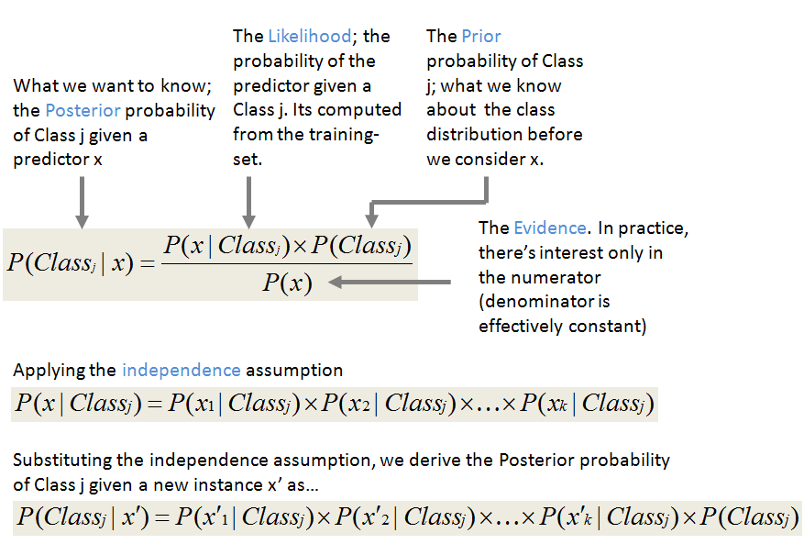

Slide 29
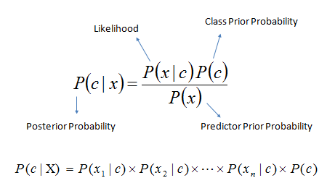
P(c|x) is the posterior probability of class (target) given predictor (attribute).
P(c) is the prior probability of class.
P(x|c) is the likelihood which is the probability of predictor given class.
P(x) is the prior probability of predictor.

Slide 30
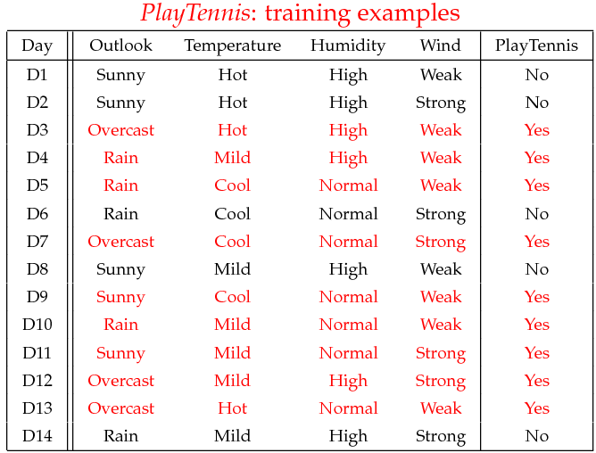
Example

Slide 31
Learning Phase
Outlook | Play=Yes | Play=No |  | Temperat ure | Play=Yes | Play=No
Sunny | 2/9 | 3/5 |  | Hot | 2/9 | 2/5
Overcast | 4/9 | 0/5 |  | Mild | 4/9 | 2/5
Rain | 3/9 | 2/5 |  | Cool | 3/9 | 1/5
Humidity | Play=Yes | Play=No
High | 3/9 | 4/5
Normal | 6/9 | 1/5
Humidity | Play=Yes | Play=No
Wind | Play=Yes | Play=No
Strong | 3/9 | 3/5
Weak | 6/9 | 2/5

Slide 32
Instance
Test Phase
Given a new instance,
x’=(Outlook=Sunny, Temperature=Cool, Humidity=High,
Wind=Strong)
P(Outlook=Sunny|Play=Yes) = 2/9 P(Temperature=Cool|Play=Yes) = 3/9 P(Huminity=High|Play=Yes) = 3/9 P(Wind=Strong|Play=Yes) = 3/9 P(Play=Yes) = 9/14
P(Outlook=Sunny|Play=No) = 3/5 P(Temperature=Cool|Play==No) = 1/5 P(Huminity=High|Play=No) = 4/5 P(Wind=Strong|Play=No) = 3/5 P(Play=No) = 5/14
P(Yes|x’): [P(Sunny|Yes)P(Cool|Yes)P(High|Yes)P(Strong|Yes)]P(Play=Yes) = 0.0053 P(No|x’): [P(Sunny|No) P(Cool|No)P(High|No)P(Strong|No)]P(Play=No) = 0.0206
Given the fact P(Yes|x’)< P(No|x’), we label x’ to be “No”.

